Slide 1
Securing Computer Folders Using Bluetooth and Rijndael Encryption Process
Group No. 11
Members : Nikita Saple
Ankita Kesarkar
Dhanraj Poojari
Guide : Prof. Alka Srivastava

Slide 2
Paper Publication Details
REVIEW PAPER
Subject :
Securing Computer Folders Using Bluetooth & Rijndael Encryption. Journal :
International Journal of Current Engineering & Technology (IJCET) Date Of Publishing :
E-ISSN 2277 – 4106
P-ISSN 2347 - 5161
February 20, 2015, Vol.5, No.1 (Feb 2015) Impact Factor: 4.550
RESEARCH PAPER
Subject :
Improving Security for Folders in Windows by Using Bluetooth and Rijndael Encryption. Journal :
International Journal of Current Engineering & Technology (IJCET) Date Of Publishing :
E-ISSN 2277 – 4106
P-ISSN 2347 - 5161
April 25, 2015,
Vol.5, No.2 (April 2015)
Impact Factor : 4.550

Slide 3
Password
ADVANTAGES
Secure
User friendly
Prevents snooping
BLUETOOTH
+
PASSWORD
Decentralized system
User personalized
Two factor authentication
FULLPROOF System
Point to point short range communication
DISADVANTAGES
Password Reuse
LC-5
Human error

Slide 4
Literature Survey Table
Author | Reference | Description
Philip Inglesant & M. Angela Sasse | The True Cost of Unusable Password Policies: Password Use in the Wild@2010 | P-P short range communication Multi connection Wireless solutions
Joan Daemen & Vincent RiJmen | The First 10 Years of Advanced Encryption@2010 | Key-iterated cipher Resistance against cryptanalysis Simplicity & performance
Dr. Zahir Zainuddin, & Evanita V Manullang | “E-Learning Concept Design Of Rijndael Encryption Process” @2013 | Rijndael algorithm has 4 processes Sub bytes transformation Shift rows transformation Mix columns transformation Add round key
Christian Rathgeb and Andreas Uhl | Two-Factor Authentication or How to Potentially Counterfeit Experimental Results in Biometric SystemS@2010 | Authentication level high Personal & physical factors Biometric traits Decentralized system
Wankhade S.B, Damani A.G, Desai S.J, Khanapure A.V | An Innovative Approach to File Security Using Bluetooth@2013 | Symmetric key encryption Bluetooth device MAC address

Slide 5
Literature Survey Table
Author | Reference | Description
Ms. Reetu Awasthi & Dr. (Mrs) R. A. Ingolikar | A Study Of Biometrics Security System @2013 | Expensive Physical presence of user False acceptance/rejection Fail to enrol rate
AlFayyadh, Bander, et al | Improving usability of password management with standardized password policies @2012 | Satisfied only theoretical risks Increase in cost Inadequate policies
Harini, N., and T. R. Padmanabhan | 2CAuth: A new two factor authentication scheme using QR-code(Quick response) @2013 | Feasibility evaluation Correctness Security evaluation Mobile holder (attack)
Florêncio, D. & Herley, C. | A Large-Scale Study of Web Password Habits @2007 | Bit-strength analysis Password type analysis Password forgetting
Adams, Anne, and Martina Angela Sasse | Users are not the enemy @1999 | Increase individual accountability Reduce frequent password Password content Multiple passwords Users’ perceptions of security

Slide 6
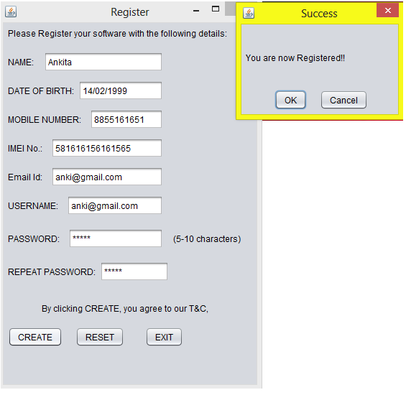
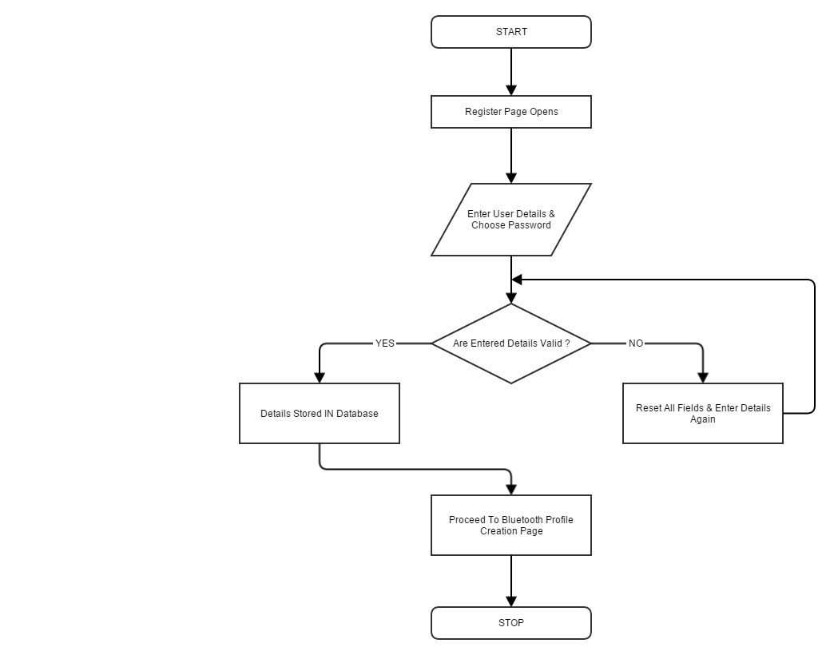
Successful registration in Registration Page

Slide 7
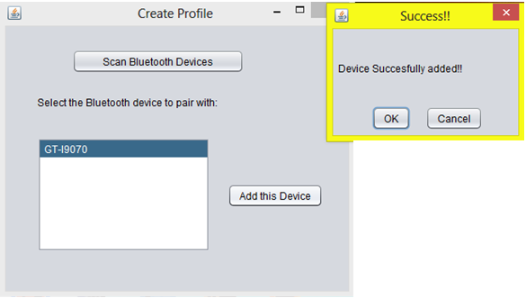
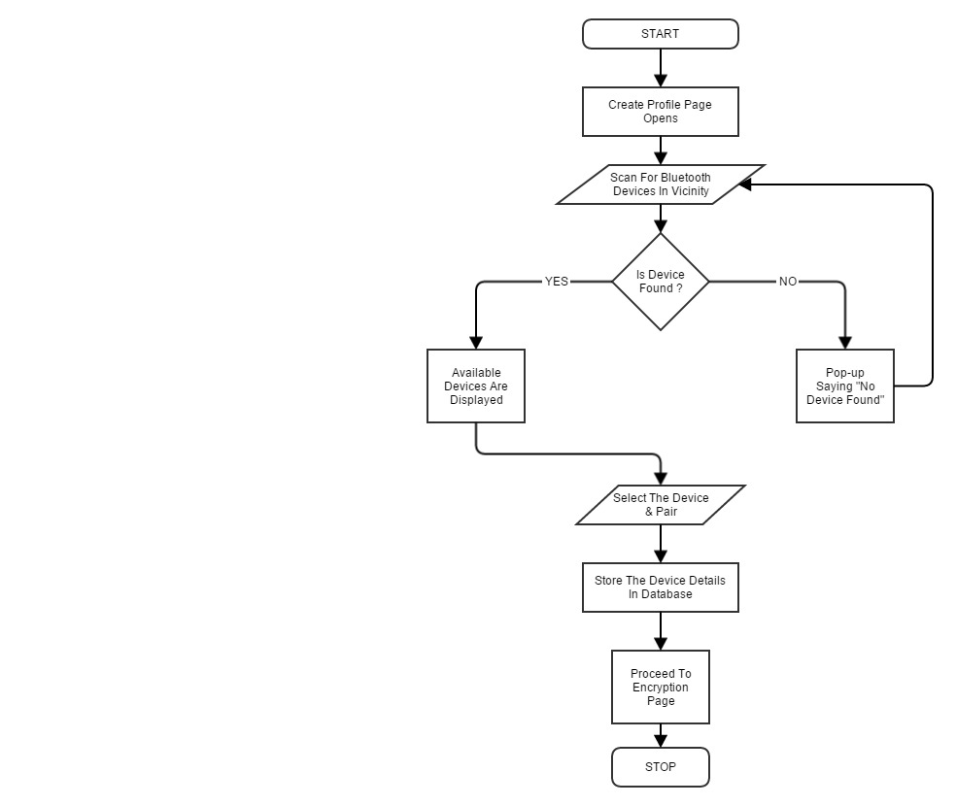
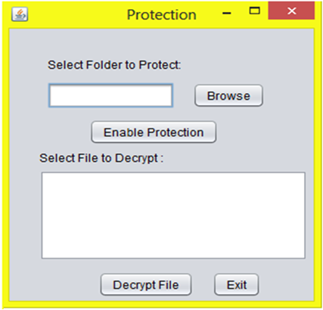
Successful Bluetooth pairing & encryption

Slide 8
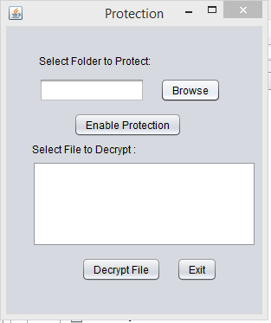
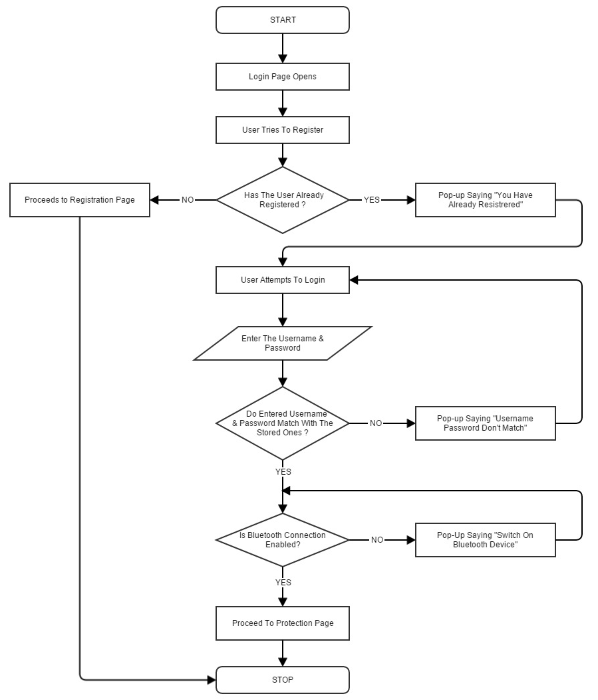
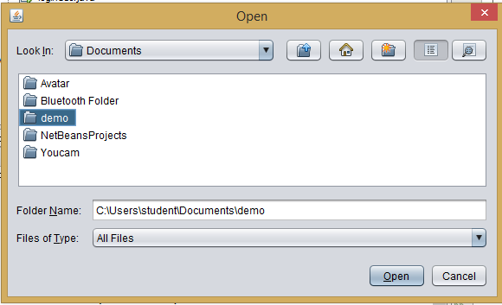
Successful Login

Slide 9
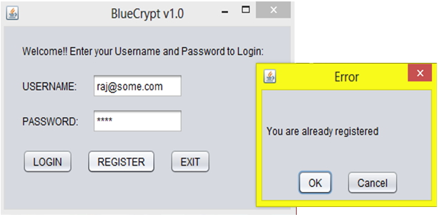
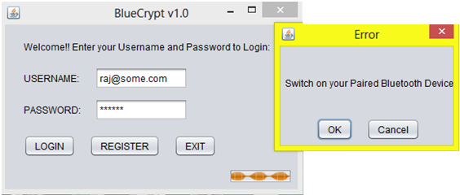
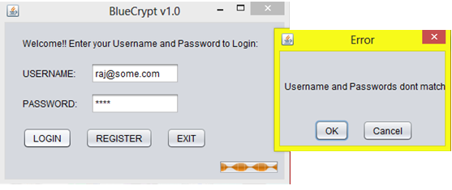
Unsuccessful Login

Slide 10
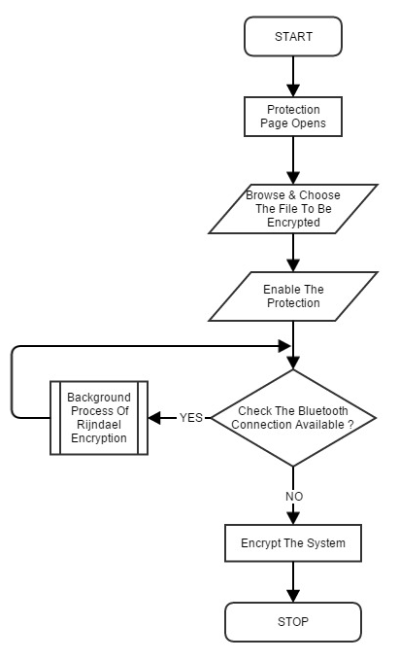
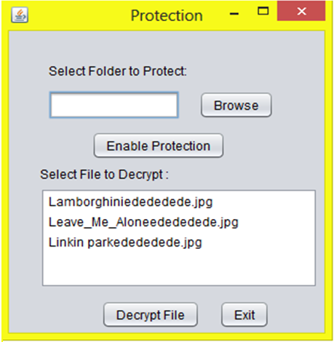
Successful Encryption

Slide 11
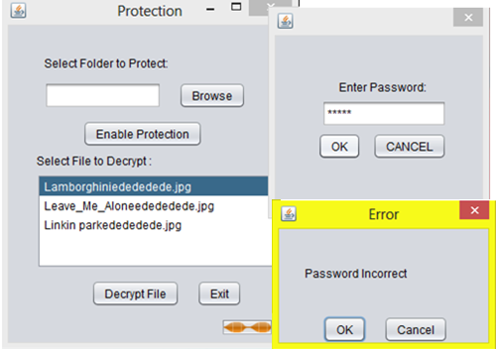
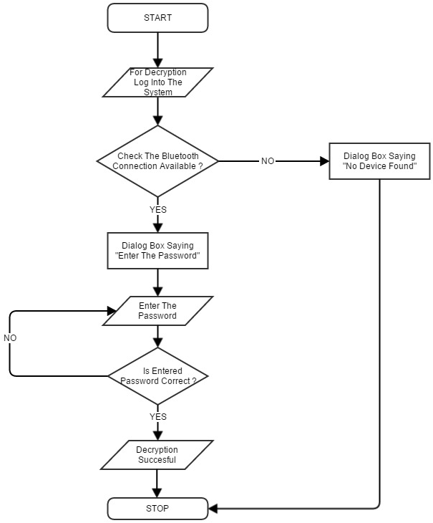
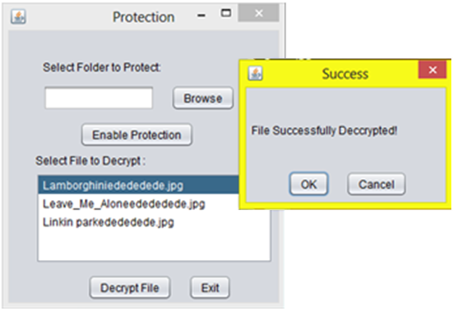
Cases on Decryption

Slide 12
Implementation Details
 | Requirement | Used Entity
 | Operating System | Windows 8, 8.1
Software Requirements | Development Environment | NetBeans IDE
 | Bluetooth Supporter | Bluecove – JSR 82
 | Database | MySQL
 | Database Connector | JDBC, XAMPP
 | Server | Apache
 | Programming Language | Java SE6 (Core & Advanced)
 | Processor/RAM | Pentium 4 and above/512 MB+
Hardware Requirements | Bluetooth | Bluetooth enabled computer/dongle for non Bluetooth enabled computers, Bluetooth enabled mobile phone.

Slide 13
Testing Methods
Alpha Testing
Validation testing
Unit Testing
Integration Testing
Beta Testing
Application
Personal Use
Organizations
Defense & Hospitals
Researcher Centre's & Laboratories
NGO’s & Banks

Slide 14
Limitation
Single user profile
.
Single device
.
No recovery in case of phone loss / device change
.
Only for windows OS
.
No password changing facility
.

Slide 15
Conclusion
Less frequent password changes
Less stringent policies
Use of proximity sensors
WINDOWS+ BLUETOOTH

Slide 16


